Slide 1
CLASS OF
1983
REUNION

Slide 2
IT’S BEEN
YEARS!

Slide 3
Remember When…
There were no CELL PHONES. VHS Tapes. Records. Dial Phones. No Seat Belts.

Slide 4
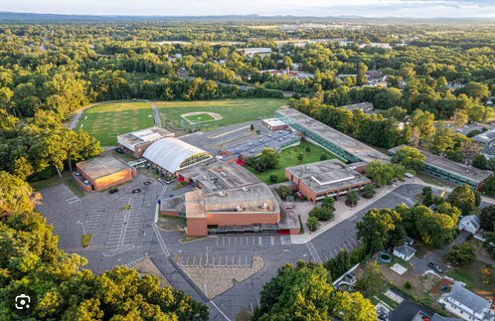

Slide 5
CLASS OF 1983 Valedictorian & Salutorian
Theresa Tanguay Valedictorian
Kristin Blackwell Salutorian

Slide 19
Junior Prom

Slide 20
Junior Prom

Slide 21
Junior Prom

Slide 22
Autumn Car Wash

Slide 23
Autumn Car Wash

Slide 24
Autumn Car Wash

Slide 25
Senior Doors

Slide 26
Senior Doors

Slide 29
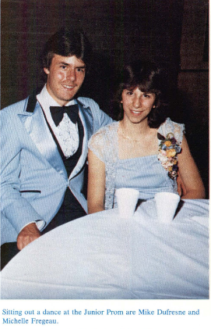

Slide 39
Part Time Jobs

Slide 40
Part Time Jobs

Slide 41
Part Time Jobs

Slide 42
Part Time Jobs

Slide 43
Senior Dress Up Day May 26, 1983

Slide 44
Senior Dress Up Day May 26, 1983

Slide 45
Senior Dress Up Day May 26, 1983

Slide 46
Senior Clash Day May 2\8, 1983

Slide 47
Senior Clash Day May 2\8, 1983

Slide 48
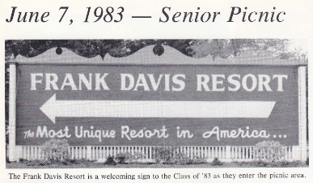
Senior Picnic June 7, 1983

Slide 49
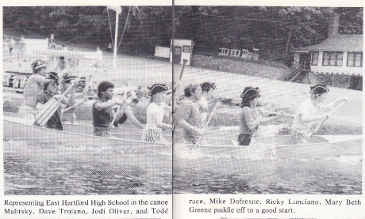
Senior Picnic June 7, 1983

Slide 50
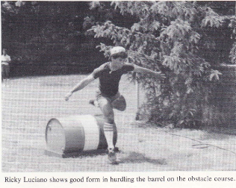
Senior Picnic June 7, 1983

Slide 51
Senior Picnic June 7, 1983

Slide 52
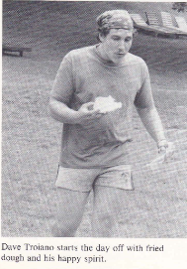
Senior Picnic June 7, 1983

Slide 53
Senior Banquet June 9, 1983

Slide 54
Senior Banquet June 9, 1983

Slide 55
Senior Ball June 10, 1983

Slide 56
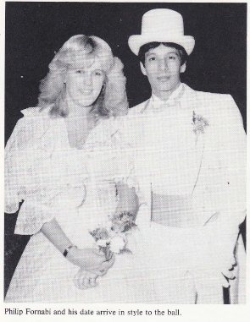
Senior Ball June 10, 1983

Slide 57
Graduation June 15, 1983

Slide 58
Graduation June 15, 1983

Slide 59
Graduation June 15, 1983

Slide 60
In Memory
Your memory will live on within the class of 1983.

Slide 61
Chris Smith

Slide 62
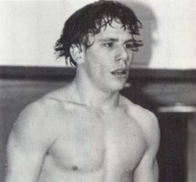
Michael P. Kreuzer Jr.
September 12, 1965 October 20, 2008

Slide 63
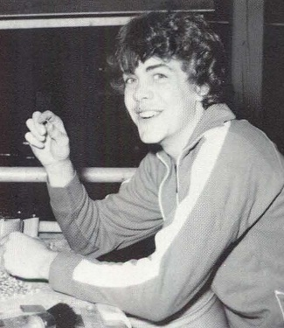
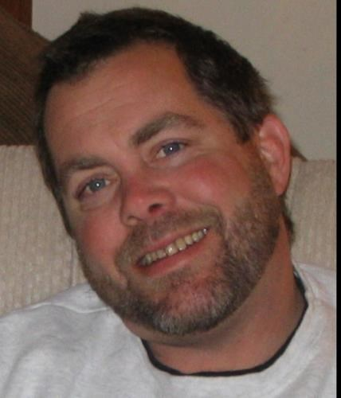
John J. Haley
August 7, 1965 August 1, 2017

Slide 64
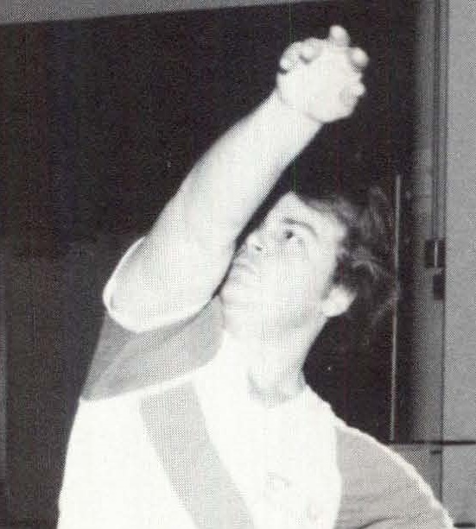
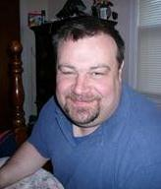
James 'Drew' Monaccio
October 8, 1965 February 16, 2017

Slide 65
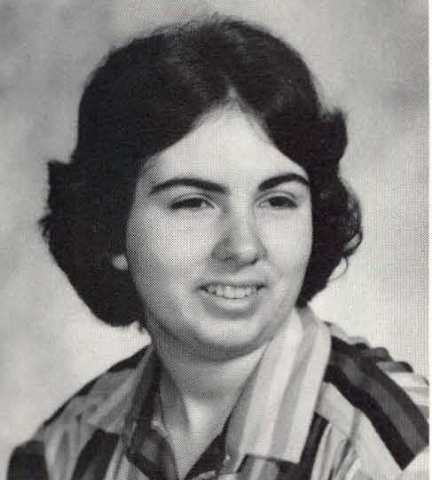
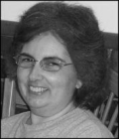
Anita Stella Falletti
March 14, 1965 October 27, 2012

Slide 66
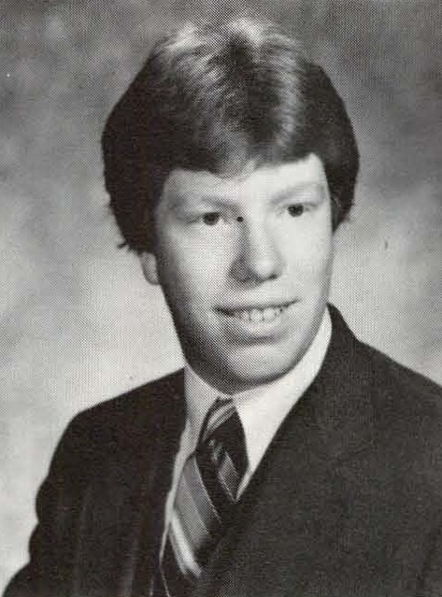
Tom Brault
May 29, 1965 February 28, 2010

Slide 67
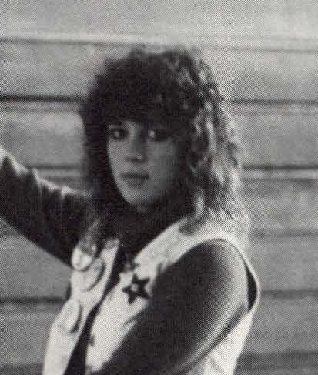
Debbie Moreau
June 22, 1965 January 25, 2016

Slide 68
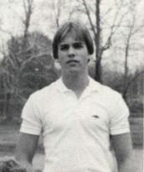
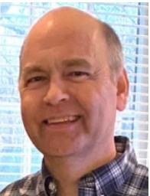
Scott Elliott
January 15, 1965 August 15, 2021

Slide 69
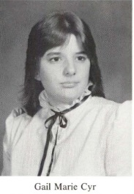
Gail Marie Cyr
May 5, 1965 - December 7, 2021

Slide 70
Many Thanks to John Fagan for organizing our 40th reunion!
Slide Show by: Steve Daly

Slide 71
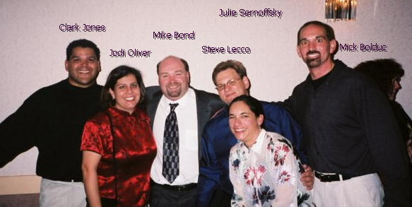

Slide 88
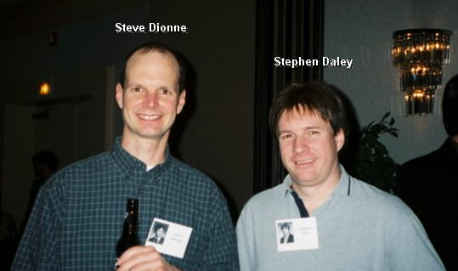

Slide 89
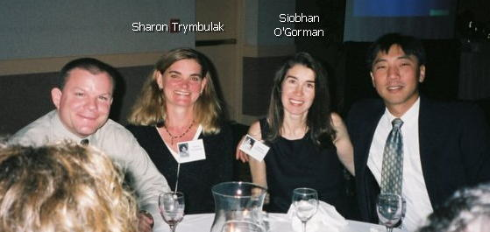

Slide 90
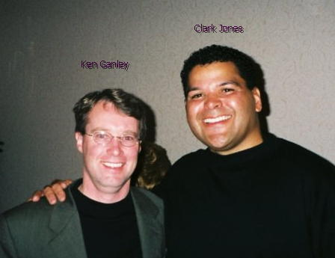

Slide 91
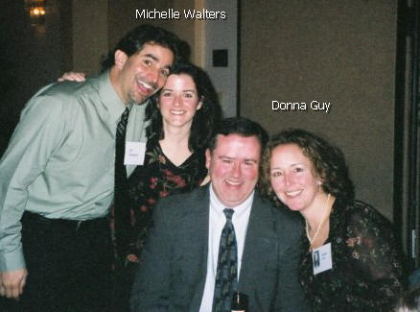

Slide 92
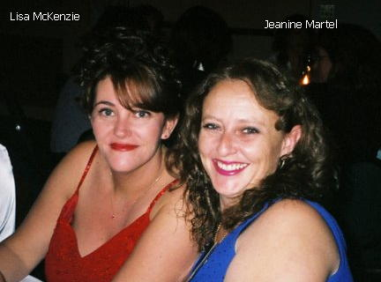

Slide 93
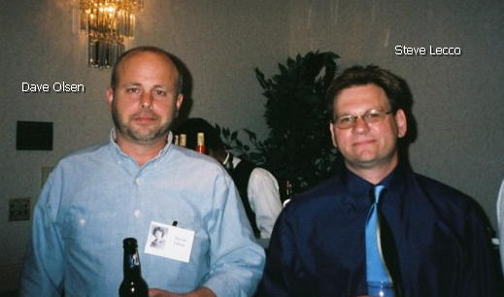

Slide 94
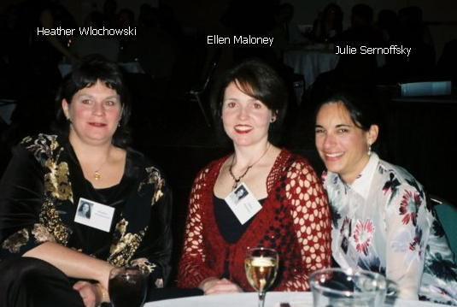

Slide 95
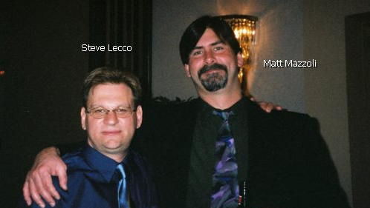

Slide 96
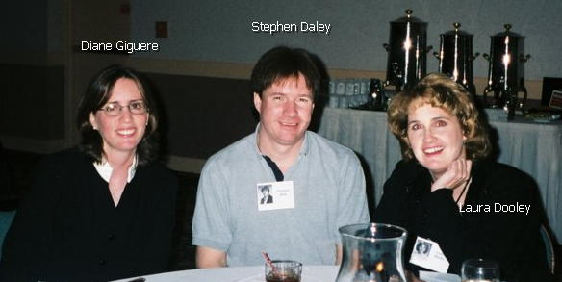

Slide 97
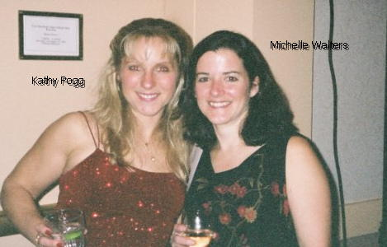

Slide 98
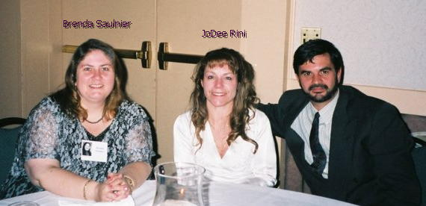

Slide 99
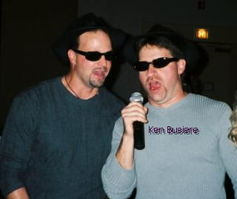

Slide 100
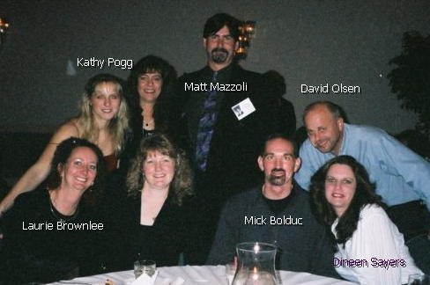
Sue Archambault

Slide 101
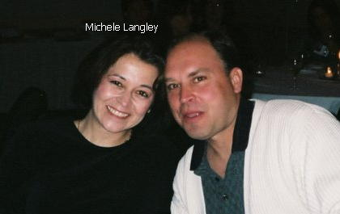

Slide 102
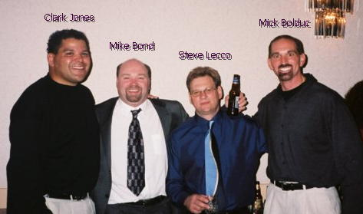

Slide 103
